Slide 1
Markov Chain Model Case Study Project

Slide 2
1.Introduction to stochastic models
2. Introduction to application
3. Model applied in application
4. Conclusion
agenda

Slide 3
stochastic models are:
Mathematical models that deal with the analysis of random events and the probability of their occurrence.
Used to study systems that are subject to uncertainty and randomness.
Based on probability theory, which provides a framework for the analysis of random events.

Slide 4
Introduction to Stochastic Models:
Stochastic models can be classified into two main categories
discrete-time
models
continuous-time models

Slide 5
Introduction to Stochastic Models:
Stochastic models can also be classified into two main types
Markov models
non-Markov models

Slide 6
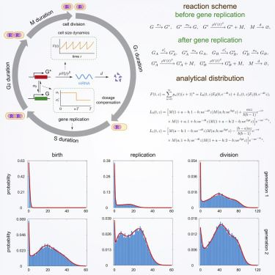
Introduction to application
The application of "A Markov Chain Model for Gene Expression with Replication" by S. Dasgupta and S. Lahiri is in the field of molecular biology.
Using in capture the stochastic nature of gene expression and replication processes in biological systems.
By simulating the transitions between different states of gene expression and replication as a Markov Chain.
predicting the variability of gene expression and replication .
Developing more effective drugs that target the variability in gene expression and replication.
(Figure 1)

Slide 7
Model applied in application:
Markov Chain model consists of four states representing the different stages of gene expression and replication:
1)Transcription. 2)Translation. 3) Replication. 4)Cell division.
The transitions between these states are modeled as a sequence of random events.
Using to simulate the transitions between different states of gene expression and replication.
calculate the steady-state probability distribution of the system.
The steady-state probability distribution of the system allows the authors to estimate the expected number of mRNA and protein molecules in the cell and to compare it to experimental data from a bacterial system.

Slide 8
Conclusion
Overall, the authors' Markov Chain model provides a useful tool for studying the stochastic nature of gene expression and replication in biological systems and for making predictions about the variability of these processes. By simulating the transitions between different states of gene expression and replication as a Markov Chain, the model captures the randomness of these processes and allows researchers to better understand the behavior of biological systems.

Slide 9
Thank you

